Slide 1



Python
-Mahima Manni & Vanshika Yadav

Slide 2



1.Concepts covered with respect to python-
Garbage Collection
Multithreading
Decorators
Closures
Generators
2.Use of regular expression in python.
Contents

Slide 3



Garbage Collectors

Slide 4


PYTHON’S MEMORY ALLOCATION AND DEALLOCATION METHOD IS AUTOMATIC. THE USER DOES NOT HAVE TO PREALLOCATE OR DEALLOCATE MEMORY SIMILAR TO USING DYNAMIC MEMORY ALLOCATION IN LANGUAGES SUCH AS C OR C++.
PYTHON USES TWO STRATEGIES FOR MEMORY ALLOCATION:
REFERENCE COUNTING
GARBAGE COLLECTION

Slide 5
In Python, the garbage collector is enabled by default and automatically runs periodically to clean up objects that are no longer referenced and thus are eligible for garbage collection. However, in some cases, you may want to disable the garbage collector to prevent it from running. You can do this using the gc.disable() function provided by the gc module.
IMPORT GC
# DISABLE THE GARBAGE COLLECTOR
GC.DISABLE()
# CREATE SOME OBJECTS
OBJ1 = [1, 2, 3]
OBJ2 = {"A": 1, "B": 2}
OBJ3 = "HELLO, WORLD!"
# DELETE REFERENCES TO OBJECTS
DEL OBJ1
DEL OBJ2
DEL OBJ3
# THE GARBAGE COLLECTOR IS DISABLED, SO IT WILL NOT RUN
Garbage collection is a memory management technique used in programming languages to automatically reclaim memory that is no longer accessible or in use by the application. It helps prevent memory leaks, optimize memory usage, and ensure efficient memory allocation for the program.

Slide 6

Advantages
AUTOMATED MEMORY MANAGEMENT
MEMORY MANAGEMENT MADE EASIER
EFFICIENT MEMORY CLEANUP
CUSTOMIZABLE SETTINGS
Diadvantages
IMPACT ON PERFORMANCE
THE DIFFICULTY OF MEMORY MANAGEMENT
LIMITED CONTROL OVER MEMORY MANAGEMENT
BUG POTENTIAL

Slide 7

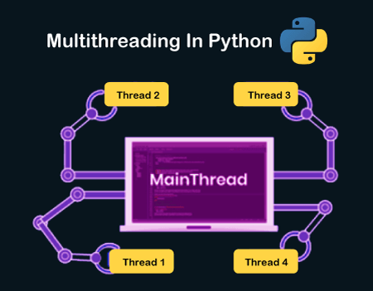

Multithreading

Slide 8
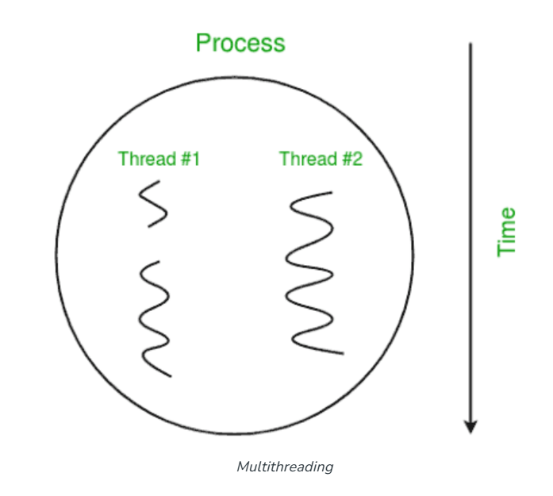
Multithreading is defined as the ability of a processor to execute multiple threads concurrently. In a simple, single-core CPU, it is achieved using frequent switching between threads. This is termed context switching. In context switching, the state of a thread is saved and the state of another thread is loaded whenever any interrupt (due to I/O or manually set) takes place. Context switching takes place so frequently that all the threads appear to be running parallelly (this is termed multitasking).

Slide 9
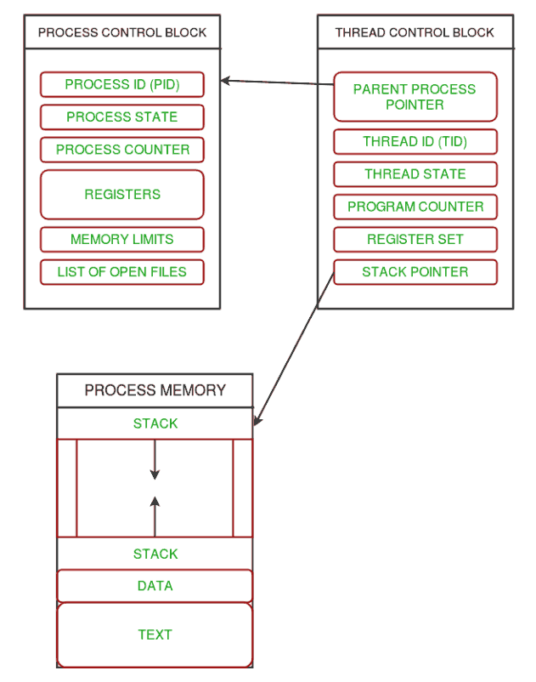

Slide 10



Decorators

Slide 11

Decorators are a very powerful and useful tool in Python since it allows programmers to modify the behaviour of a function or class. Decorators allow us to wrap another function in order to extend the behaviour of the wrapped function, without permanently modifying it. But before diving deep into decorators let us understand some concepts that will come in handy in learning the decorators.
In Decorators, functions are taken as the argument into another function and then called inside the wrapper function.

Slide 12
# defining a decorator
def hello_decorator(func):
# inner1 is a Wrapper function in
# which the argument is called
# inner function can access the outer local
# functions like in this case "func"
def inner1():
print("Hello, this is before function execution")
# calling the actual function now
# inside the wrapper function.
func()
print("This is after function execution")
return inner1
# defining a function, to be called inside wrapper
def function_to_be_used():
print("This is inside the function !!")
# passing 'function_to_be_used' inside the
# decorator to control its behaviour
function_to_be_used = hello_decorator(function_to_be_used)
# calling the function
function_to_be_used()
Output:
Hello, this is before function execution This is inside the function !!
This is after function execution

Slide 13

Closures

Slide 14

Nested functions in Python
A function that is defined inside another function is known as a nested function. Nested functions are able to access variables of the enclosing scope.
In Python, these non-local variables can be accessed only within their scope and not outside their scope.
# Python program to illustrate
# nested functions
def outerFunction(text):
def innerFunction():
print(text)
innerFunction()
if __name__ == '__main__':
outerFunction('Hey!')
As we can see innerFunction() can easily be accessed inside the outerFunction body but not outside of its body. Hence, here, innerFunction() is treated as a nested Function that uses text as a non-local variable.
Output:
Hey!

Slide 15
A Closure in Python is a function object that remembers values in enclosing scopes even if they are not present in memory.
It is a record that stores a function together with an environment: a mapping associating each free variable of the function (variables that are used locally but defined in an enclosing scope) with the value or reference to which the name was bound when the closure was created.
A closure—unlike a plain function—allows the function to access those captured variables through the closure’s copies of their values or references, even when the function is invoked outside their scope.

Slide 16
# Python program to illustrate
# closures
def outerFunction(text):
def innerFunction():
print(text)
# Note we are returning function
# WITHOUT parenthesis
return innerFunction
if __name__ == '__main__':
myFunction = outerFunction('Hey!')
myFunction()
Output:
omkarpathak@omkarpathak-Inspiron-3542: ~/Documents/Python-Programs/$ python Closures.py Hey!
As observed from the above code, closures in Python help to invoke functions outside their scope. The function innerFunction has its scope only inside the outerFunction. But with the use of Python closures, we can easily extend its scope to invoke a function outside its scope.

Slide 17

Generators

Slide 18
A generator function in Python is defined like a normal function, but whenever it needs to generate a value, it does so with the yield keyword rather than return. If the body of a def contains yield, the function automatically becomes a Python generator function.
The generator has the following syntax in Python:
def function_name(): yield statement

Slide 19
# A generator function that yields 1 for first time,
# 2 second time and 3 third time
def simpleGeneratorFun():
yield 1
yield 2
yield 3
# Driver code to check above generator function
for value in simpleGeneratorFun():
print(value)
# A Python program to demonstrate use of
# generator object with next()
# A generator function
def simpleGeneratorFun():
yield 1
yield 2
yield 3
# x is a generator object
x = simpleGeneratorFun()
# Iterating over the generator object using next
# In Python 3, __next__()
print(next(x))
print(next(x))
print(next(x))
Output:
1 2 3
Output:
1 2 3

Slide 20


Regular Expressions

Slide 21


A RegEx is a powerful tool for matching text, based on a pre-defined pattern. It can detect the presence or absence of a text by matching it with a particular pattern, and also can split a pattern into one or more sub-patterns. The Python standard library provides a re module for regular expressions. Its primary function is to offer a search, where it takes a regular expression and a string. Here, it either returns the first match or else none.
Python has a built-in package called re, which can be used to work with Regular Expressions.
Import the re module:
import re

Slide 22
Regular expression is used for the following reasons:
Data Mining: Regular expression is the best tool for data mining. It efficiently identifies a text in a heap of text by checking with a pre-defined pattern. Some common scenarios are identifying an email, URL, or phone from a pile of text.
Data Validation: Regular expression can perfectly validate data. It can include a wide array of validation processes by defining different sets of patterns. A few examples are validating phone numbers, emails, etc.

Slide 23
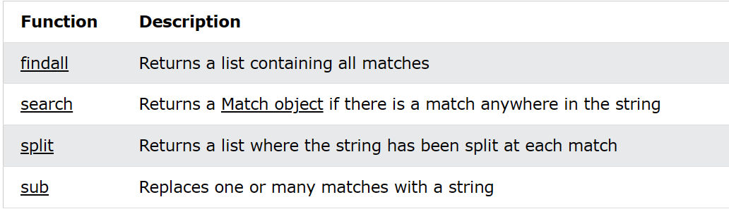
RegEx Functions
The re module offers a set of functions that allows us to search a string for a match:

Slide 24
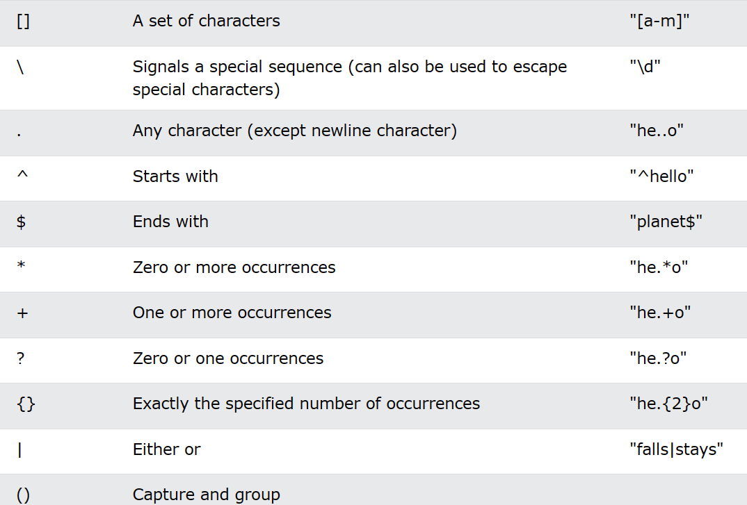
Metacharacters
Metacharacters are characters with a special meaning:

Slide 25
#findall function
import re
#Return a list containing every occurrence of "ai":
txt = "The rain in Spain"
x = re.findall("ai", txt)
print(x)
Output-
[‘ai’,’ai’]
#Regular function example with search function
import re
#Check if the string starts with "The" and ends with "Spain":
txt = "The rain in Spain"
x = re.search("^The.*Spain$", txt)
if x:
print("YES! We have a match!")
else:
print("No match")
Output-
YES!We have a match!

Slide 26
#spilt function
import re
#Split the string at every white-space character:
txt = "The rain in Spain"
x = re.split("\s", txt)
print(x)
Output-
[‘The’,’rain’,’in’,’Spain’]
#sub function
import re txt = "The rain in Spain" x = re.sub("\s", "9", txt) print(x)
Output-
The9rain9in9Spain

Slide 27

Thank
you

